Slide 1


26.01.18

Slide 2
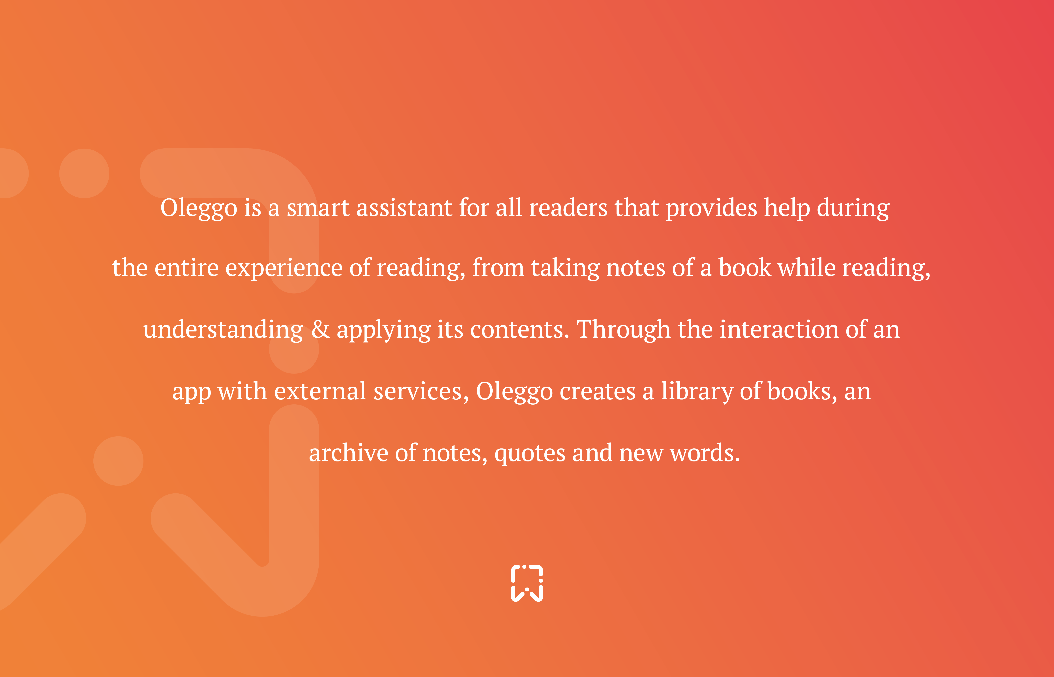

Slide 3


Why use Oleggo?
Mainly because you can have always with you your notes and a handy dictionary for each book you read.
Because you can insert notes and search the meaning of the words in a fast way using the speech recognition.
Moreover for each book you are reading you can save and update a bookmark.

Slide 4
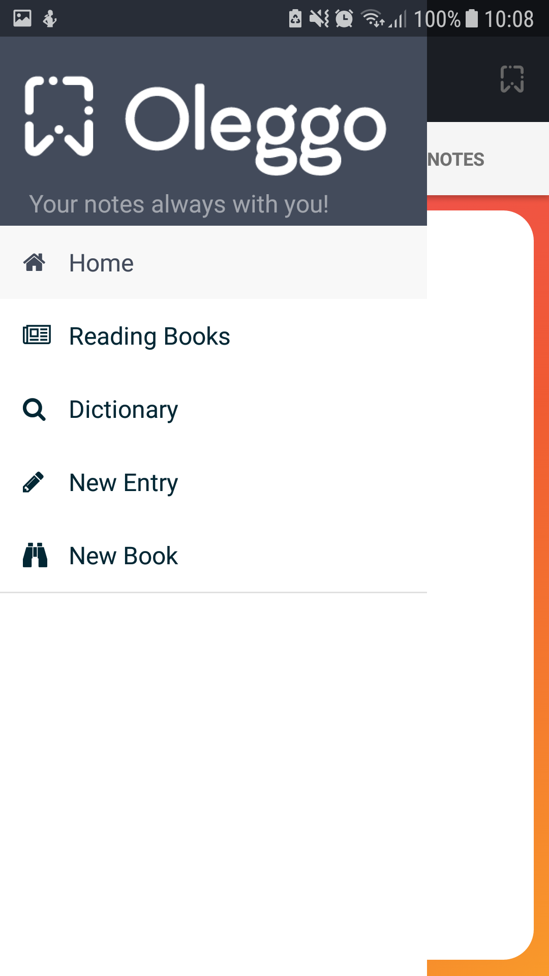

How to use Oleggo?
The application is very intuitive to use:
-The side menu at the left of the screen allows to navigate quickly between the different pages.
-The buttons on each screen were designed to have meaningful words or icons to describe its functions.

Slide 5
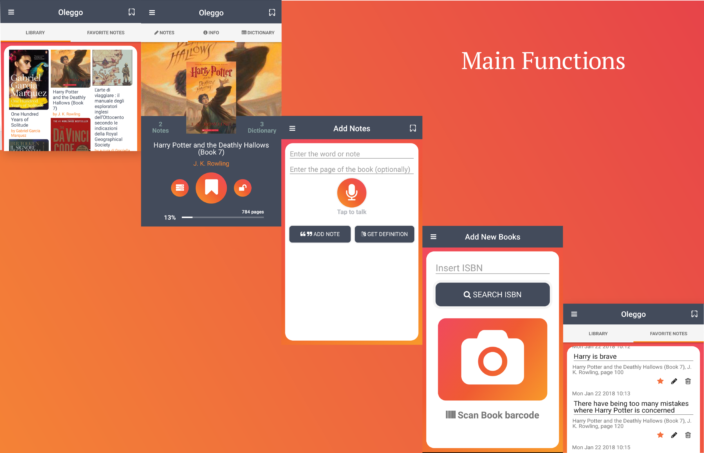
Main Functions

Slide 6
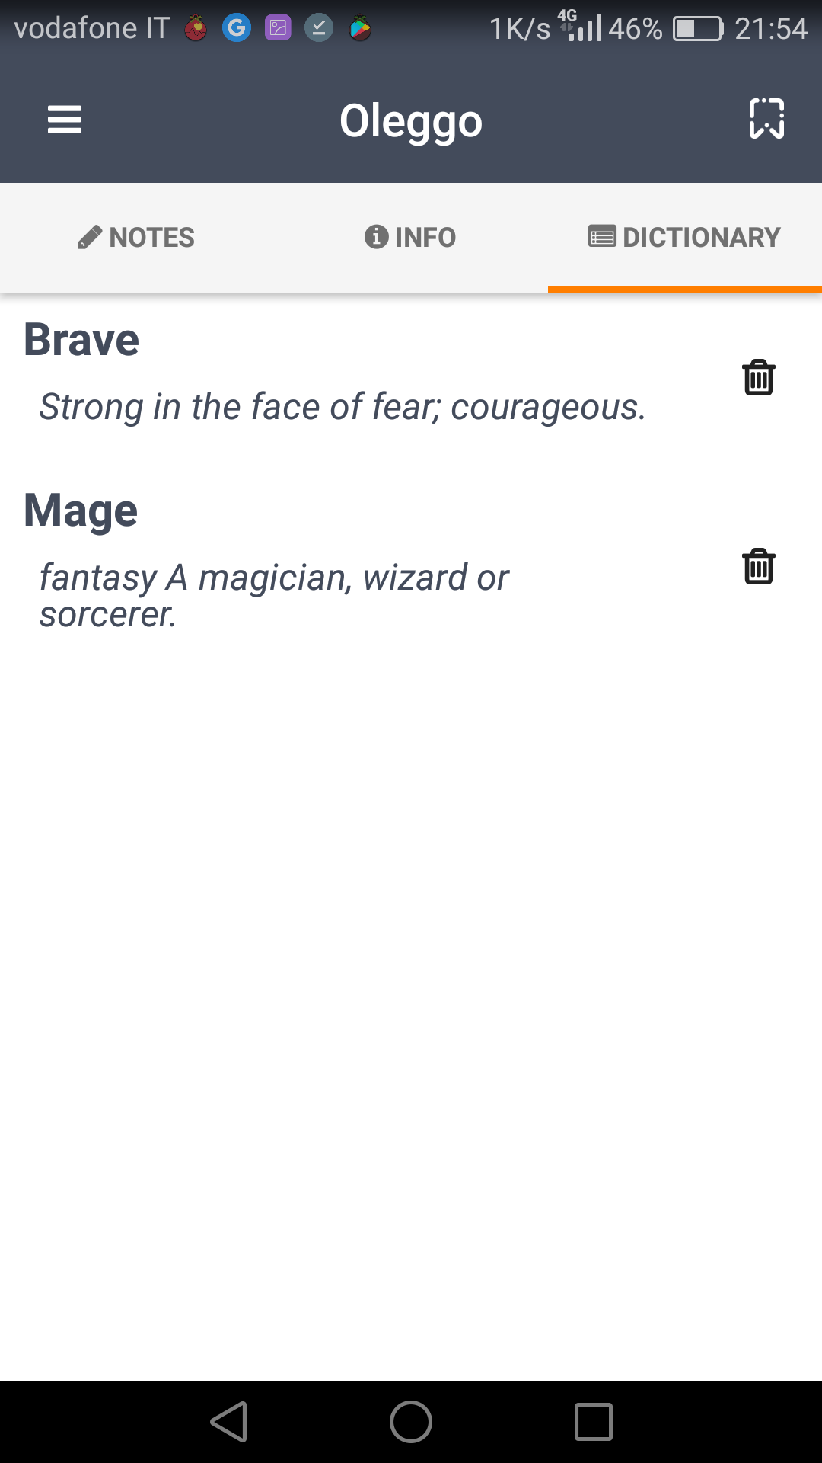
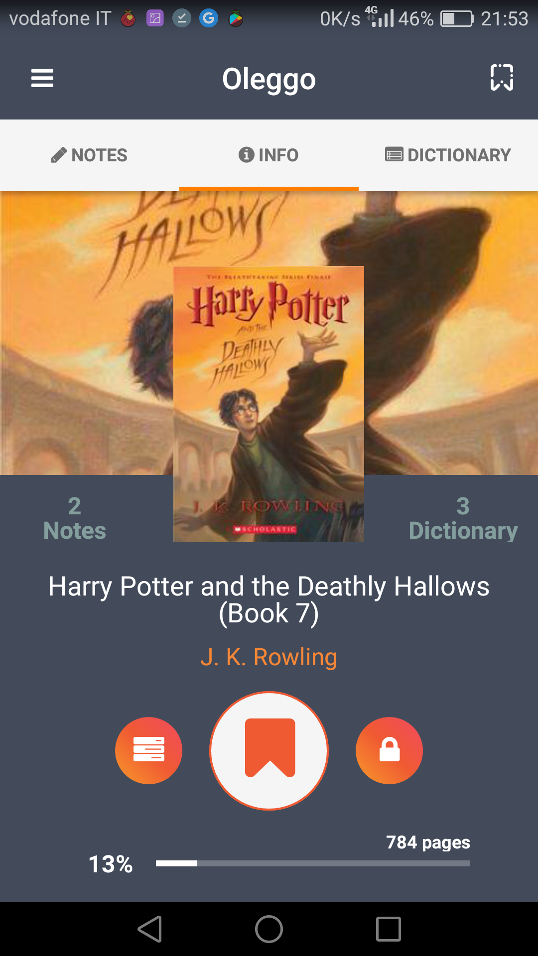
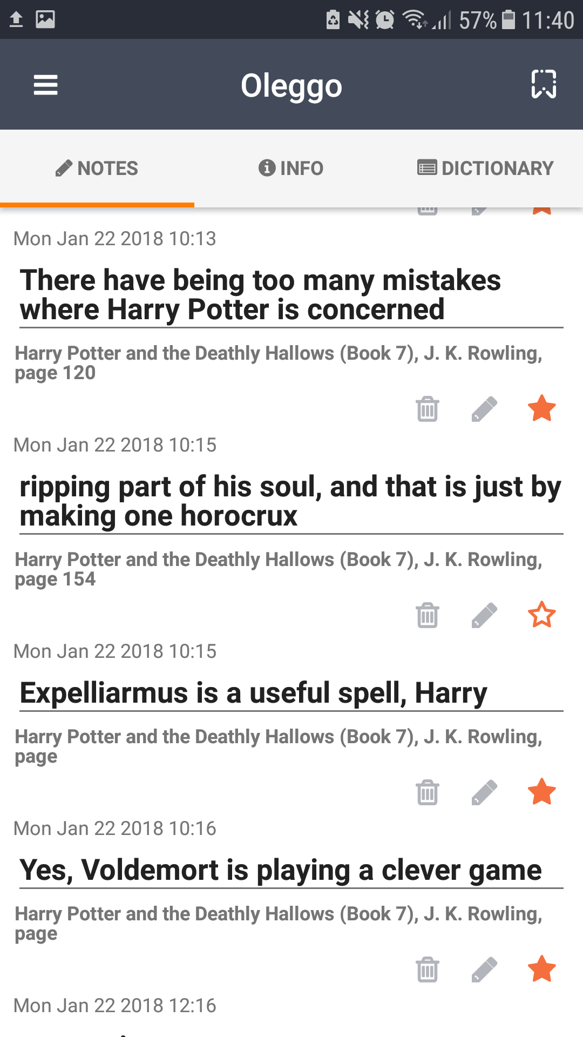
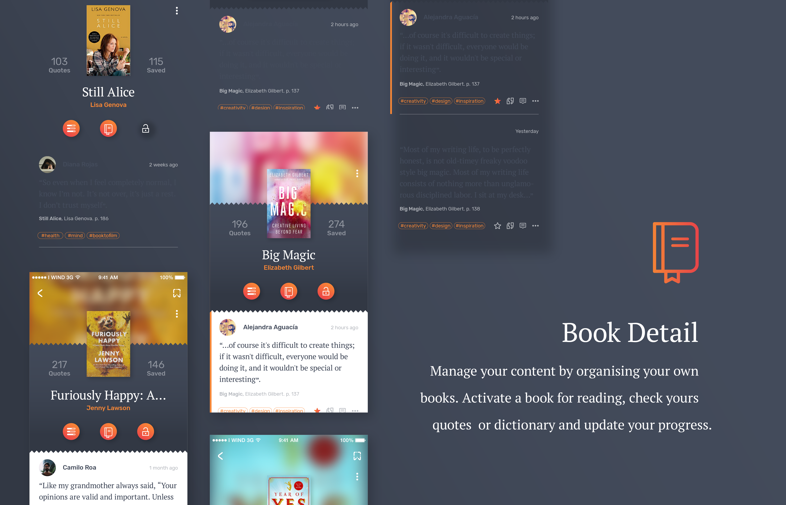
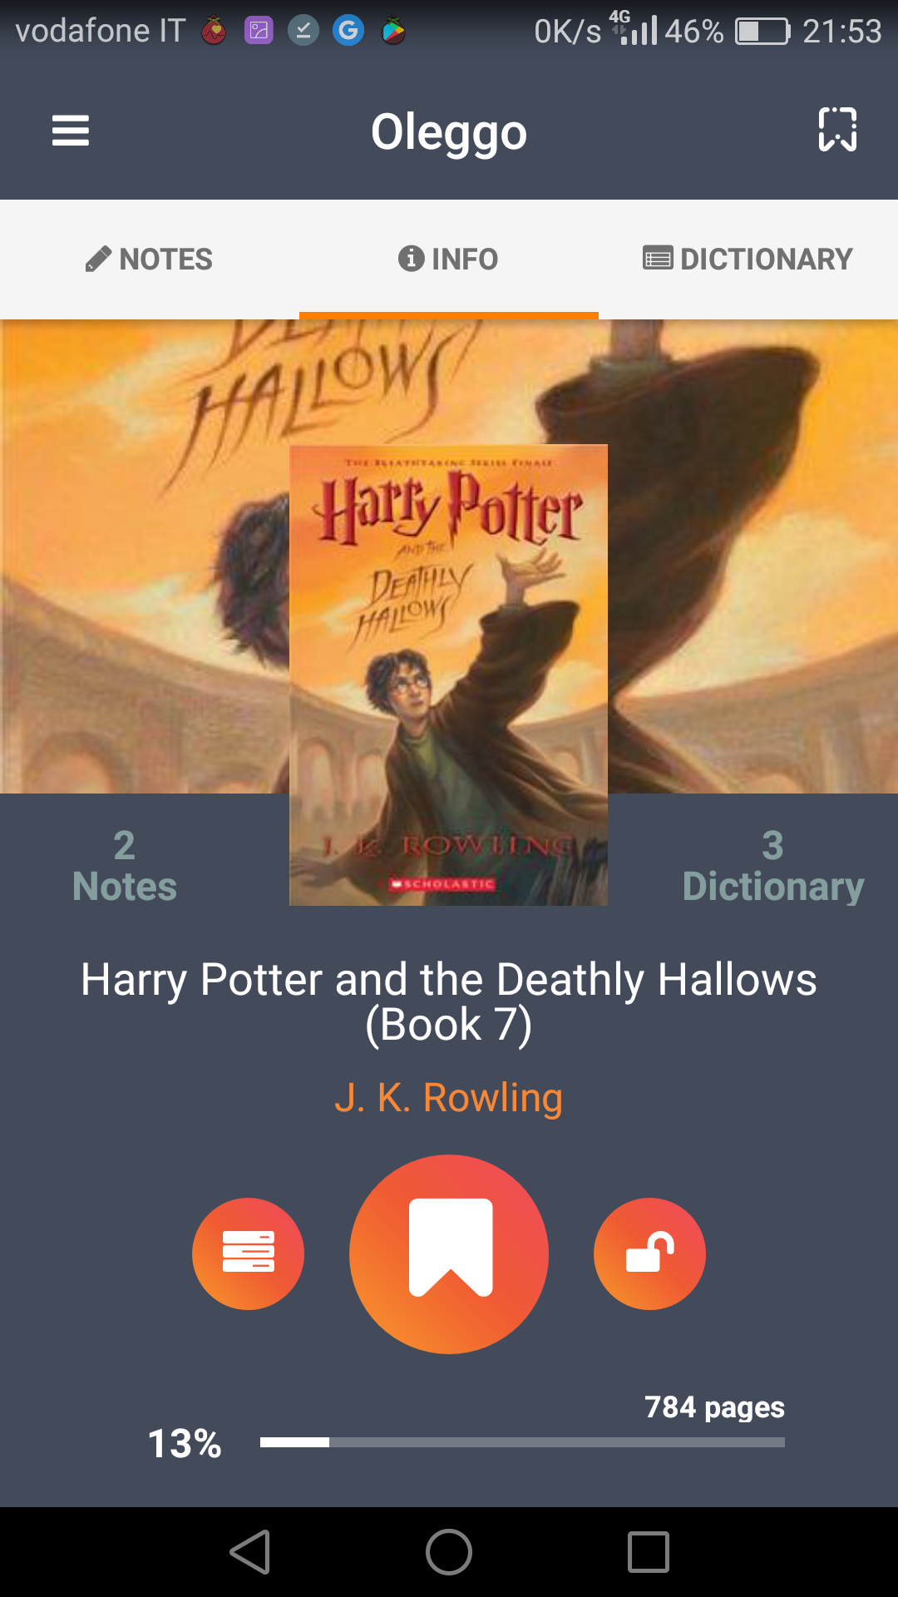
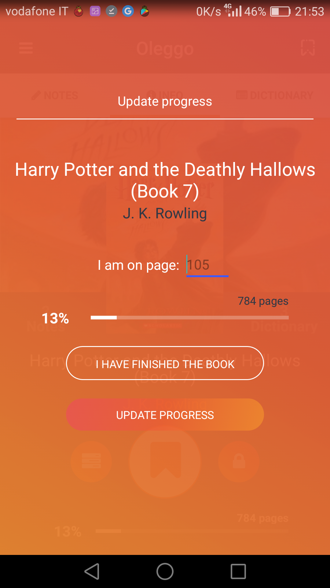
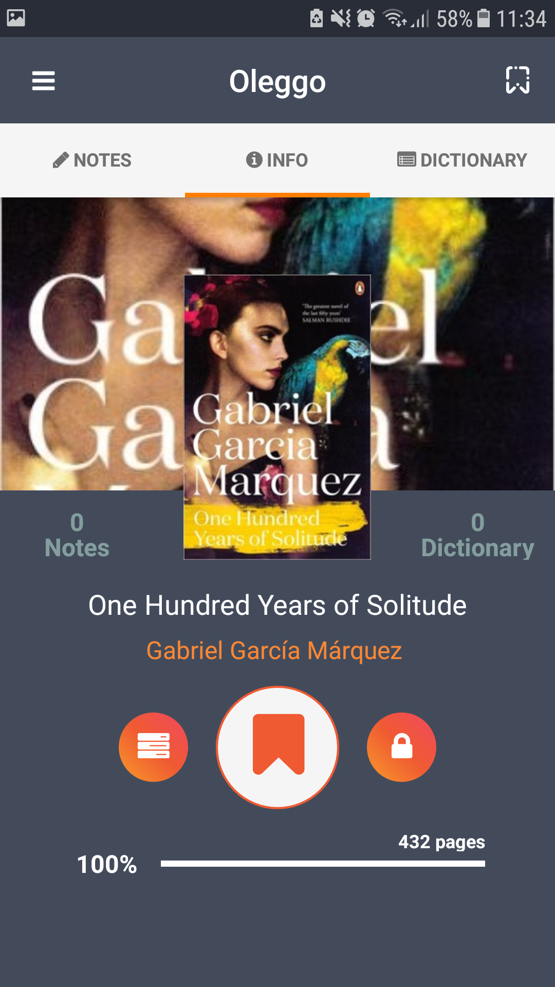

Slide 7

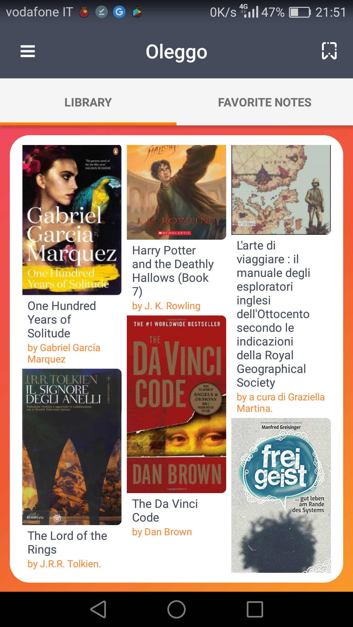
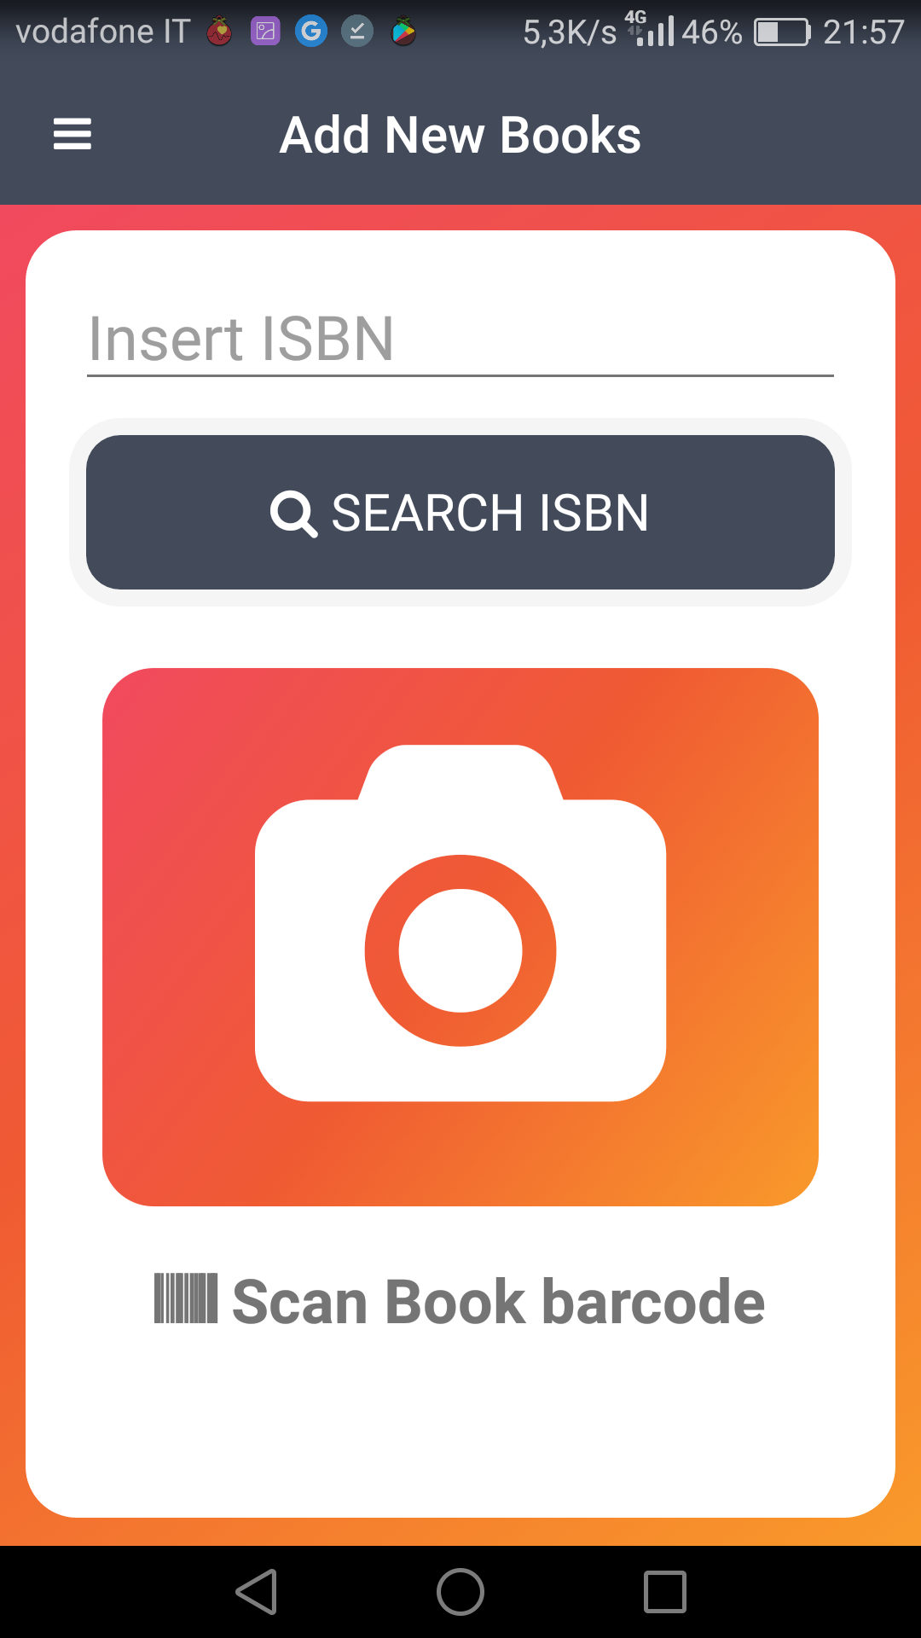


Add New Books
New book

Slide 8
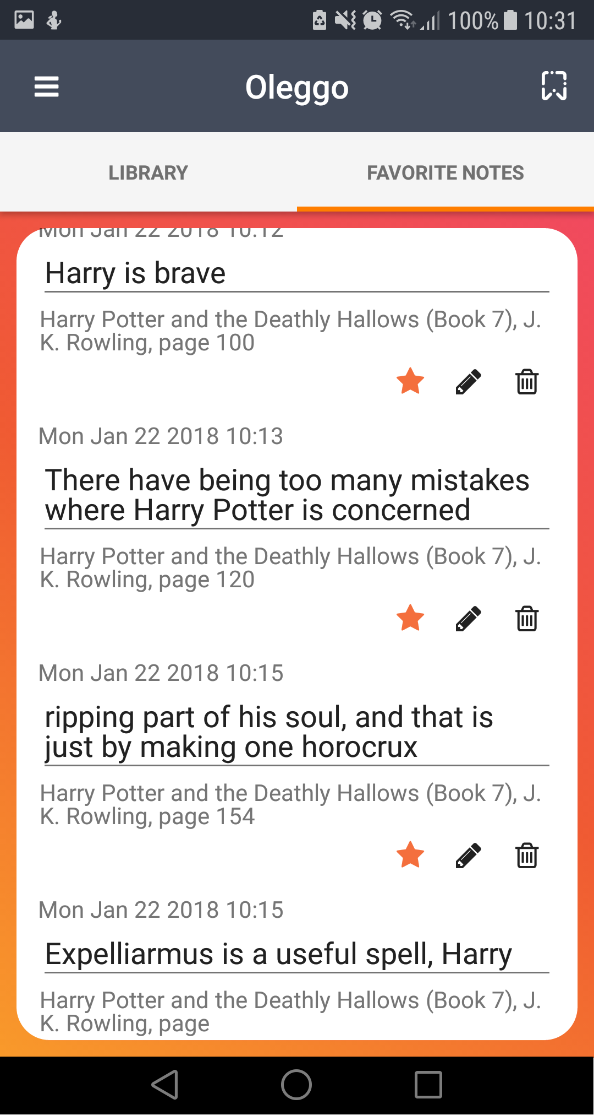
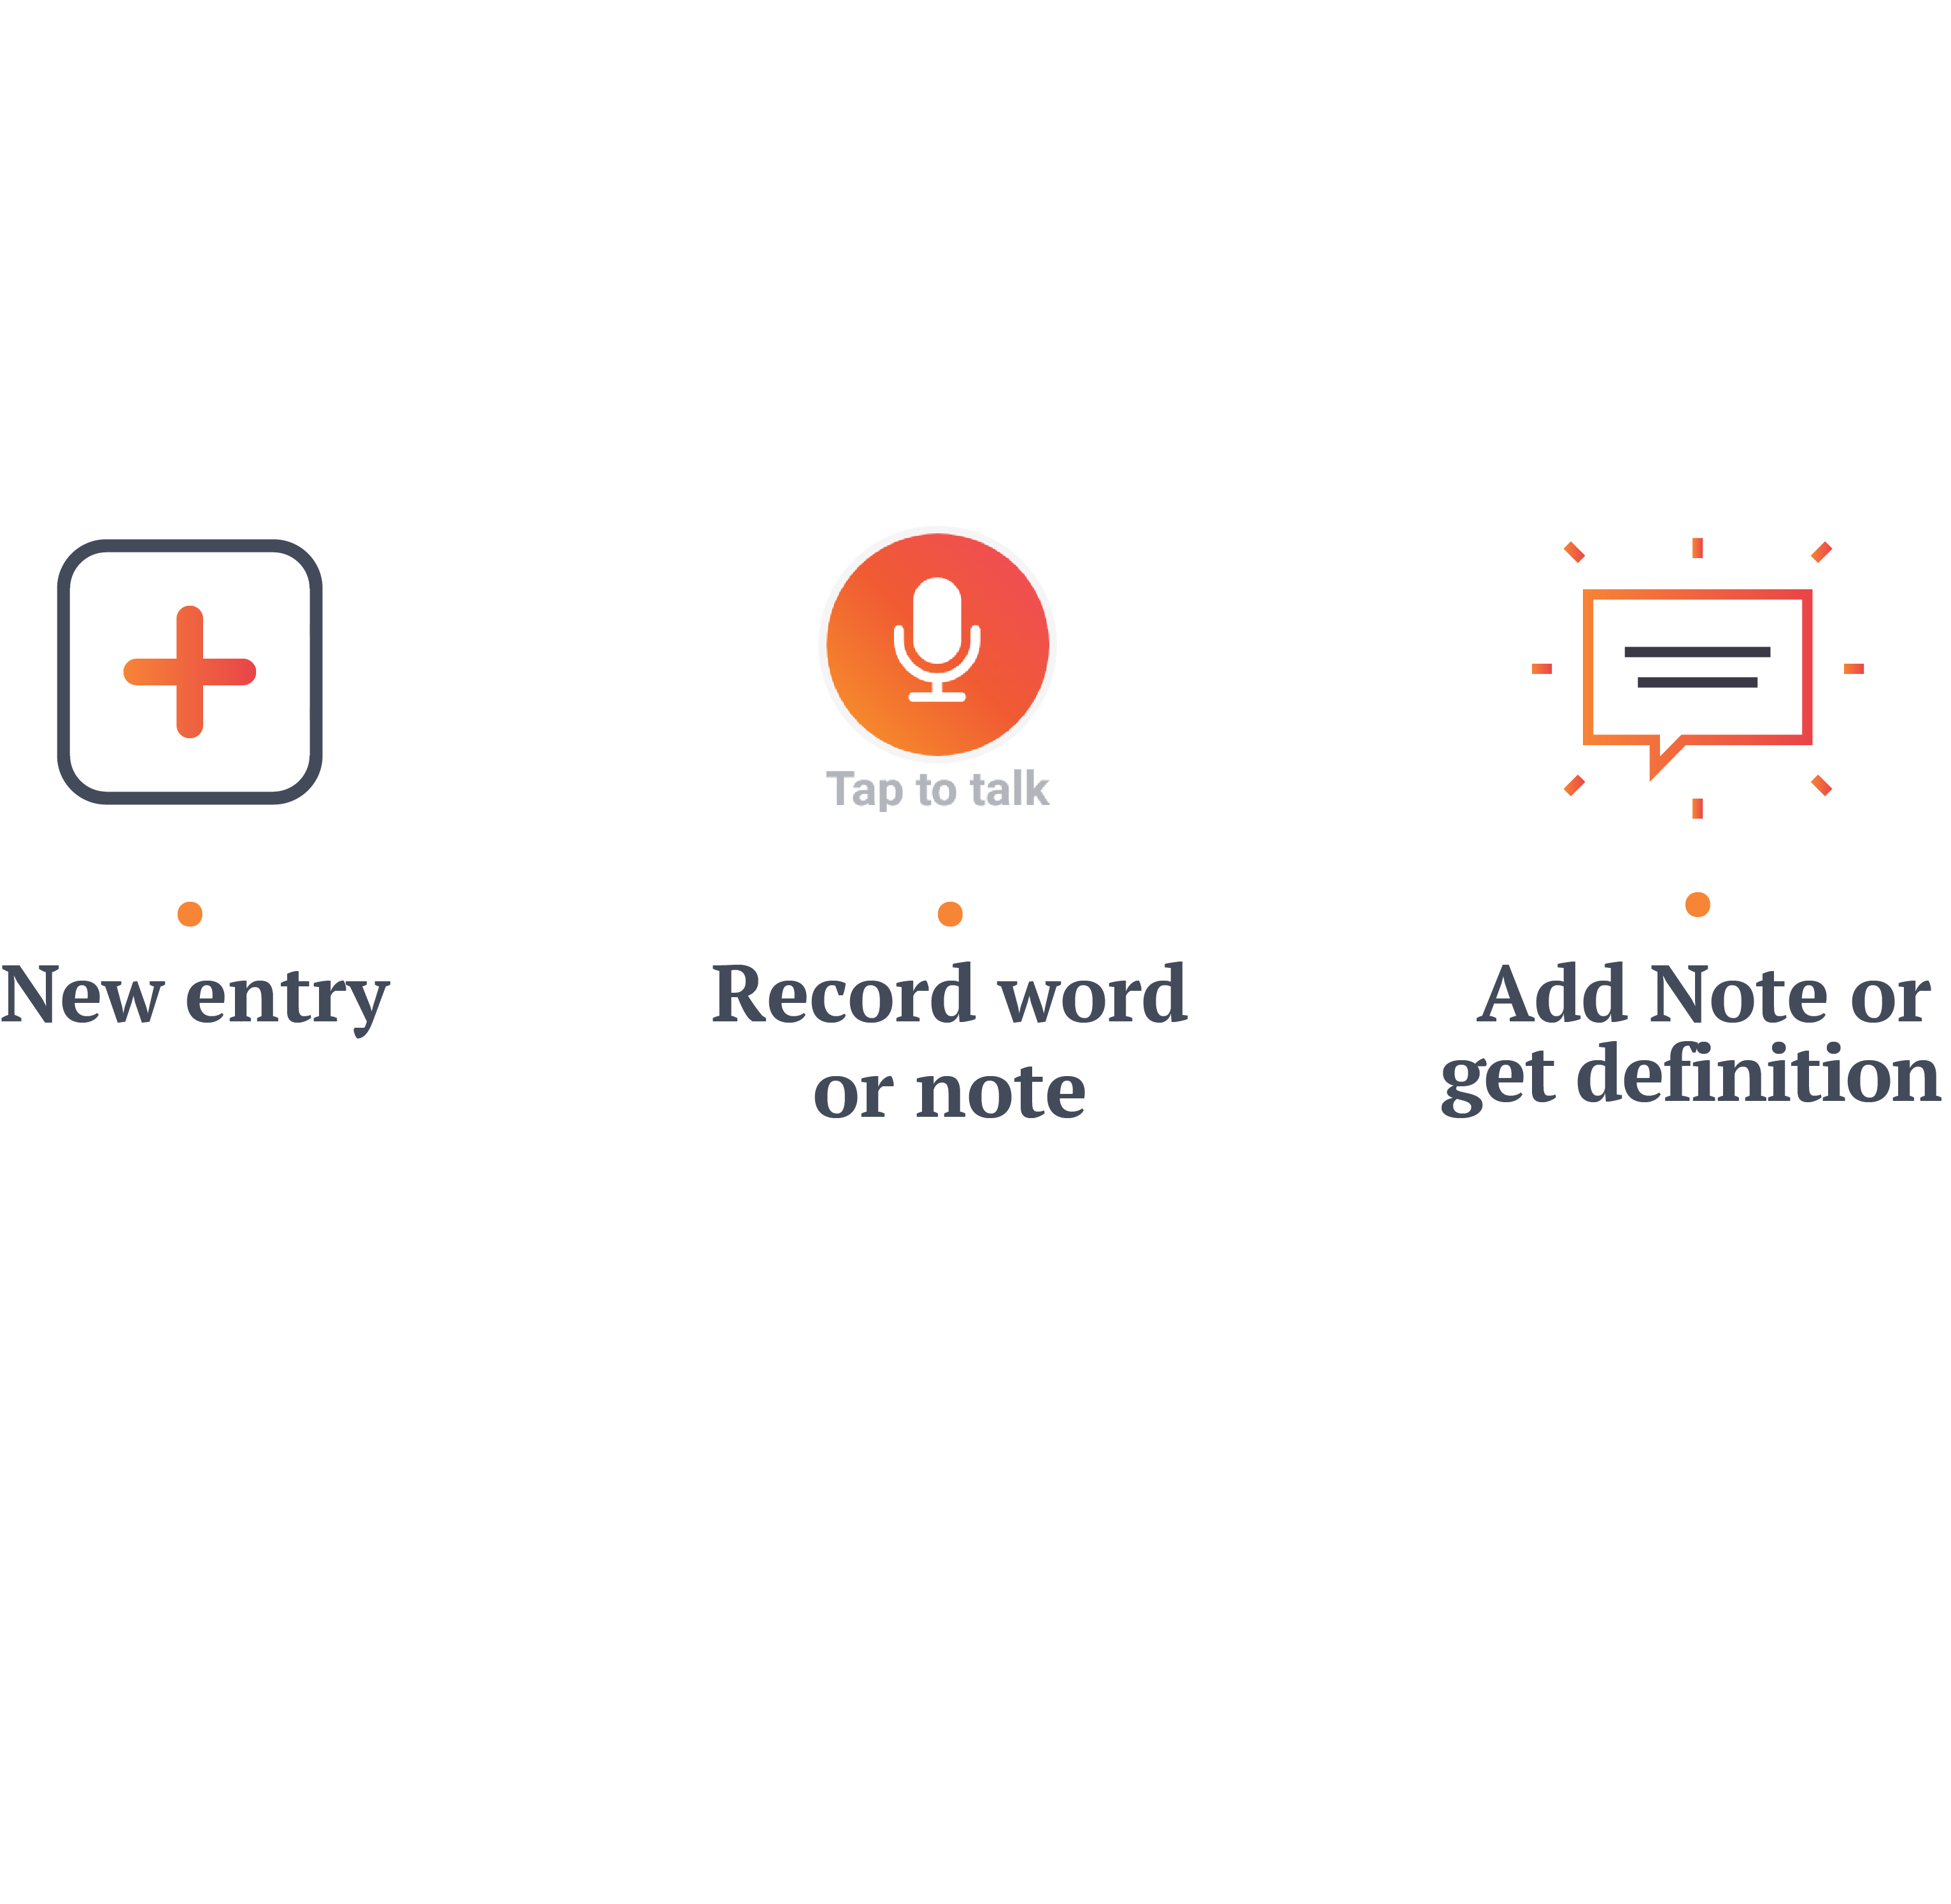
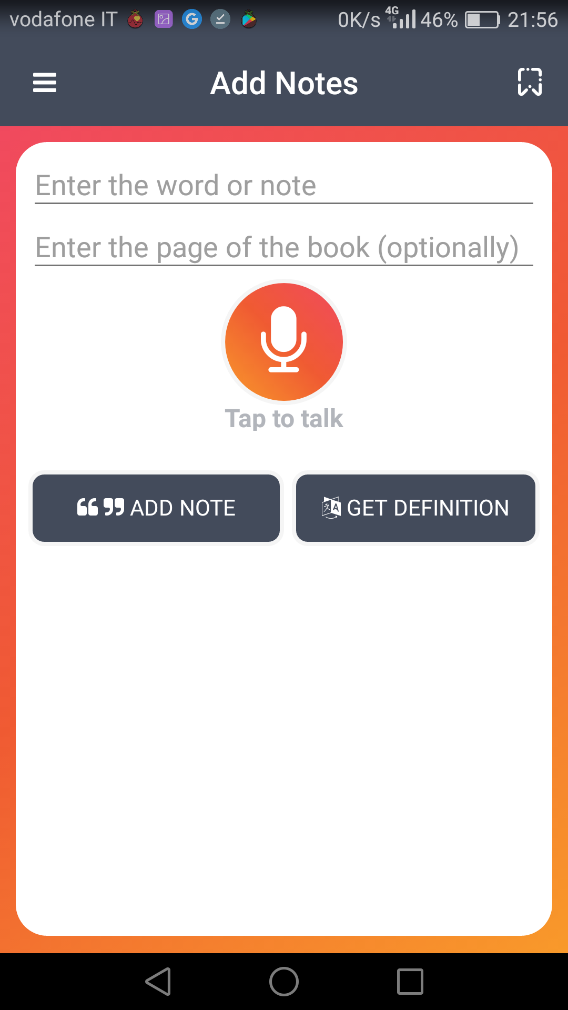
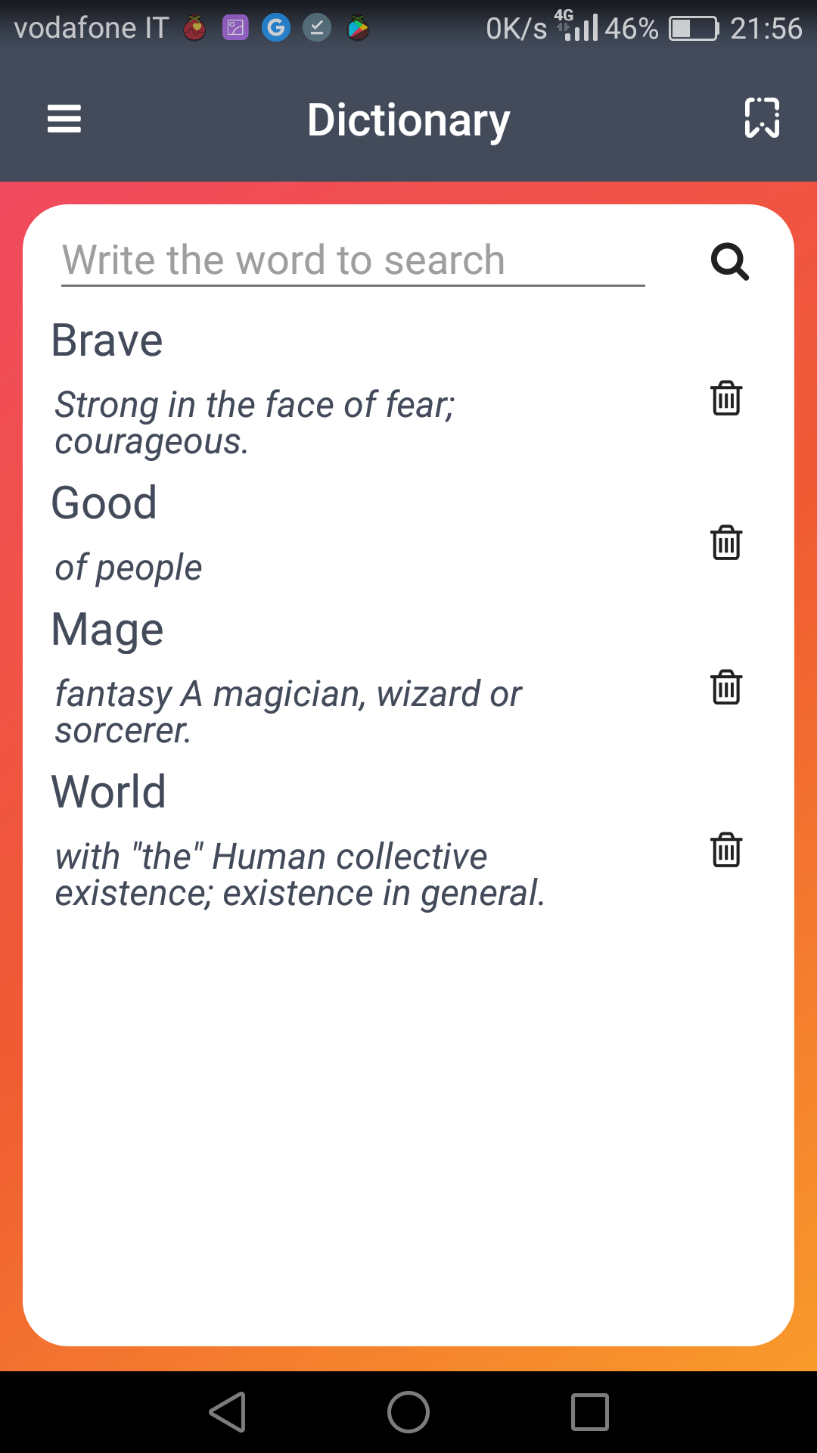
Add Notes and Words

Slide 9
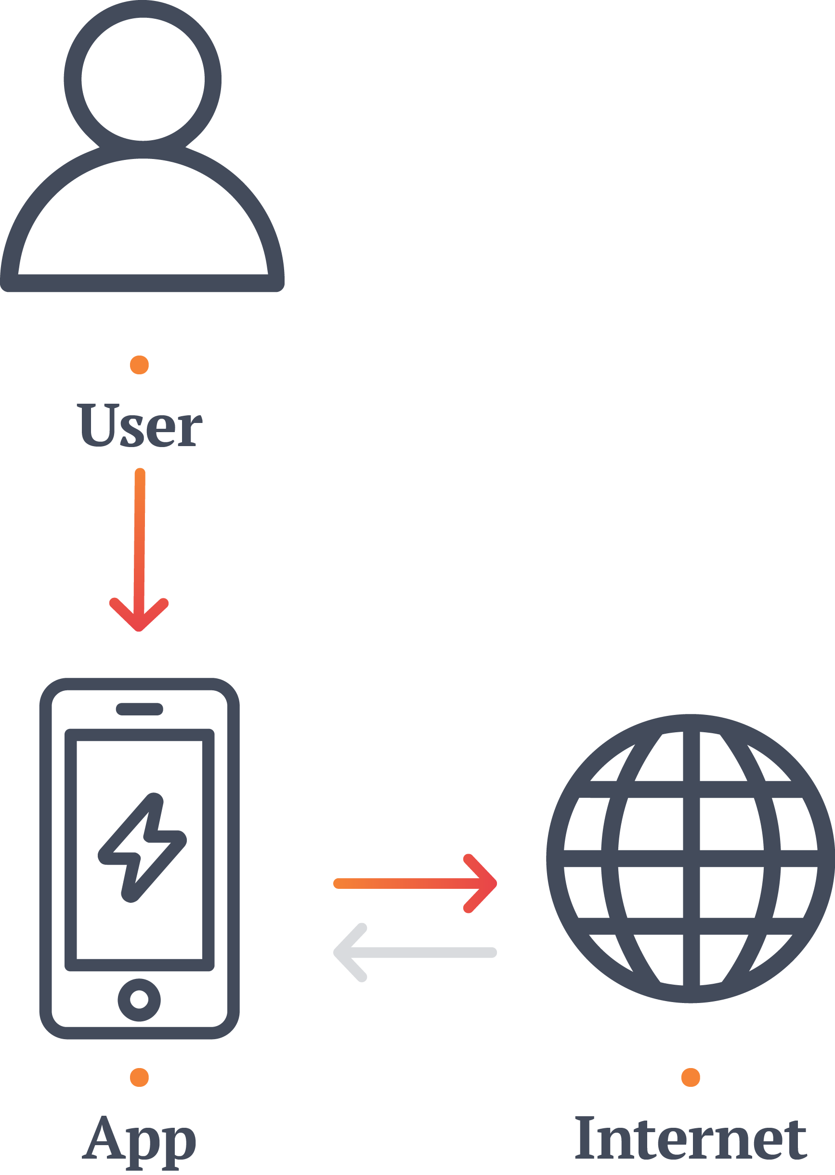



Plugins and External Services
APIs to look for information about books using ISBN.
API to search the meaning of a word.
Plugin for using the camera as barcode scanner.
Plugin for speech recognition.
Plugin for SQLlite.

Slide 10
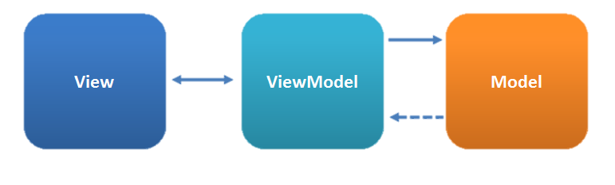
Architecture
The calls to the services that may require an extensive time to compute are done in an asynchronous way using a system object called "promise".
Database query
ISBN search
Word definition
Speech recognition
In this way eventual slowdowns caused by these operations won’t influence the application UI .

Slide 11
